Slide 1
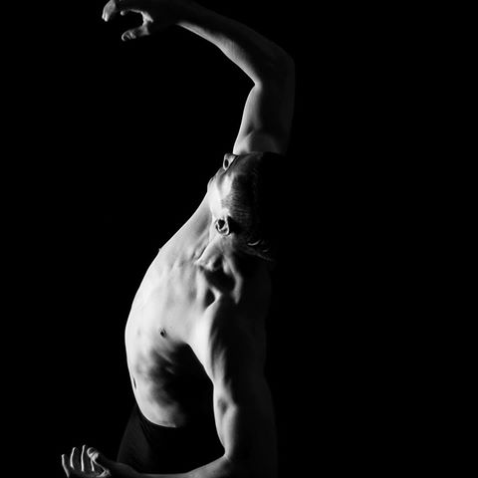
Introduction…

Slide 2
Macarena Carrascosa
Bachelor of Science:
Majors Psychology and Sport and Exercise
11 time national champion, 3 time Oceania champion
Worlds 2011-2013
Oscar Winner 2009 and 2011
Nike Run Club pacer
Science based approach to coaching
Notes:
- This is why i did my degree so that i could help educate every nz coach with a science based approach.

Slide 3
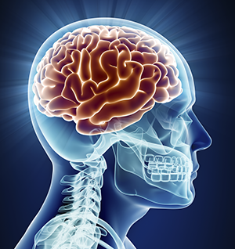
Psychological
Skill Training
The systematic and consistent practice of mental or psychological skills for the purpose of enhancing performance.
Also enhances athlete enjoyment, and teaches them skills to use in everyday life.
Notes:
Why do good kid athletes quit? Decrease in enjoyment. No longer fun.

Slide 4
What we’re doing today
Mental Toughness
What is anxiety and how to spot it (fight or flight)
Arousal definition and regulation
Skills to use with your athletes to manage their stress levels during competition and training
Imagery (visualisation)
Notes:
This presentation is based on my sport psychology and clinical psychology lectures from my last year at uni.
- I want you to come away with a handful of mental training tools to use with your skaters to help them enjoy skating more and reach their goals

Slide 5
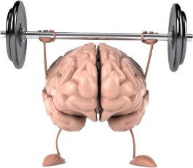
Mental Toughness in athletes
Control: over feelings and actions in all situations (especially stressful ones)
Commitment: to having an active role in training. Accountable for actions
Challenge: change seen as an opportunity to grow and develop; not a threat
Confidence: in their own ability to do well under stressful situations/everyday training
Notes:
This is what we’re aiming for and hoping all athletes are like. We want capable, confident young people who believe in themselves and aren’t afraid to step up to challenges
Why is it important
Psychological factors account for most fluctuations in sport performance from day to day
Achieving mental toughness = consistent performance
Increase enjoyment in training and competition for the athlete

Slide 6


Common Myth #1 about PST
It’s for elite athletes only
The earlier you start the better. Starting to learn psychological skills at an early age means you’ll learn control over emotions/actions in lots of different situations.
Notes:
1. For elite athletes only: the earlier you start the better. Starting to learn psycholigcal skills at an early age means you’ll learn control over emotions/actions in lots of different situations. Also easier to learn skills in a relaxed environment before you actually need to use the skills for real because stress affects how you learn.

Slide 7
Common Myths #2 about PST
It’s for ‘problematic’ athletes only
Learning skills before you need them, will help the learning process.
Notes:
2. For problematic athletes only: learning skills before you need them, will help the learning process. We learn better when we’re not stressed. If you’re already stressed, makes it hard to retain info (learn in pre season, practise throughout)

Slide 8
Common Myth #3 about PST
It’s not useful.
False. Can help anyone at any stage including people who don’t compete as these skills are coping mechanisms for everyday situations as well.
Notes:
3. Not useful: False. Can help anyone at any stage including people who don’t compete as these skills are coping mechanisms for everyday situations as well

Slide 9
Common Myth #4 about PST
It’s time consuming.
Mindfulness can be done anywhere at any time for only a few seconds. Once you learn the skills, they’re with you for life so you can use them at any time.
Notes:
4. Time consuming: mindfulness can be done anywhere at any time for only a few seconds. Once you learn the skills, they’re with you for life so you can use them at any time.

Slide 10
Common Myth #5 about PST
You’re “just born with mental toughness” and it can’t
be learned
Not true! You can learn to manage your anxiety during stressful situations. You can deal with stress in a healthy way.
Athletes are not doomed for failure if they don’t naturally know how to deal with stress and change. They can be taught.
Notes:
5. “just born with it”: not true. You can learn to manage your anxiety during stressful situations. You can deal with stress in a healthy way. Athletes are not doomed for failure if they don’t naturally know how to deal with stress and change. They can be taught. I was definitely not “born with it”. Had to learn it the hard way and it’s never perfect
Ultimately, Mental toughness can be built so that the athlete can deal with stress better.
Eg: we’re talking about helping that skater that falls apart at comps but in training they’re amazing

Slide 11
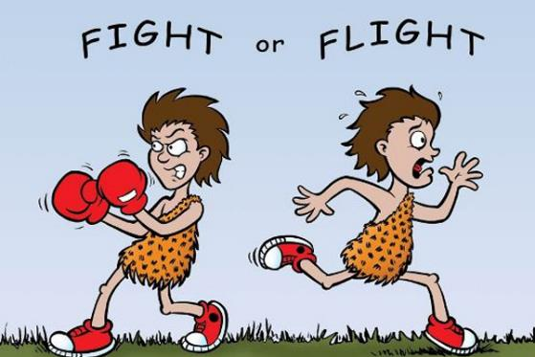
Stress & Anxiety

Slide 12
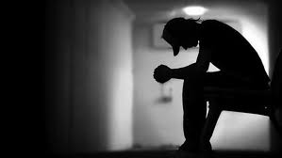
What is anxiety?
“a future-oriented mood state associated with preparation
for possible, upcoming negative events”
Notes:
- Anxiety focuses on the future. Always worried about what might happen. Includes perceiving the future situation as a threat. Normal reaction to stress

Slide 13


Almost universal human experience
An evolution of primal survival instincts.
Bad experience, but useful under the right conditions
Notes:
Fight or flight response: A response which triggers a flood of changes to your hormones, neurotransmitters, and body to prepare you to immediately run away or fight danger
- Anxiety stops you from acting in ways that are likely to compromise your survival
- Picking a fight with someone much bigger
- Driving your car at 200KPH.
- not useful now that there are no predators lurking around every corner.

Slide 14
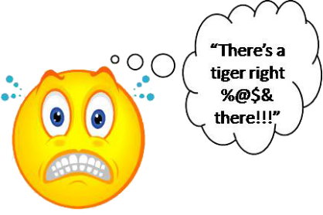
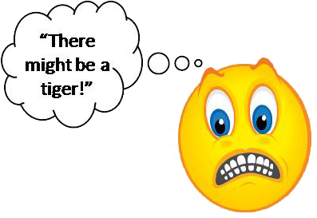
Fear vs Anxiety
FEAR: “an alarm response to present or imminent danger (real or perceived)”
ANXIETY “a future-oriented mood state associated with preparation for possible, upcoming negative events”
Notes:
Almost interchangeable in the sense that both can trigger the fight or flight response and the thing sounding the alarm can be real or perceived.

Slide 15
Functional Anxiety
Anxiety is the normal and adaptive response to anticipated danger (stress)
Prioritises attention on threat appraisal and mobilises bodily resources to deal with the danger or escape (Fight, flight, freeze)
Fight or flight helpful in certain circumstances
  Being attacked, car accident or natural disaster
Unhelpful when inappropriately triggered
  When giving a speech in class
  Going on a date or job interview
Notes:
Threat appraisal is useful when trying to decide what to focus your energy on. If there’s a deadline that you need to meet, it’s useful to that first. But at competitions, you don’t need to be worrying about everyday things.

Slide 16
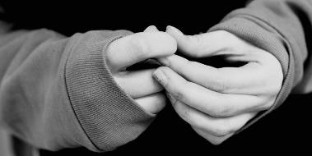
Features of Anxiety
Mental processes:
Worry, self doubt, FEAR
Unease
Repetitive negative thoughts
Difficulty concentrating
Confusion
Depersonalization
Physical features of anxiety...
Physical processes:
Increased heart rate
Rapid breathing/ Hyperventilation
Sweating more than usual
Stomach ache
Headache
Muscle tension/aches
Shaking
Nausea/butterflies
Notes:
- Depersonalization: feeling of being detached from oneself. Extreme case of anxiety but it’s that feeling where you don’t believe that this is “happening”. Major freak outs. Common with panic attacks
things to look for in our athletes. Physical features will be easier to spot. Gives us an indication that it’s time to use one of the psych skills to calm them down
how many times have we heard in the marshalling area “i feel sick, i can’t do this, i need to pee, i need to get out of here”? These are all forms of anxiety and can be addressed with the right tools. We don’t need to send out a skater onto the floor who is already freaked out before even stepping on the floor. There is a way to help them. They are not doing it to themselves and they are not helpless.

Slide 17
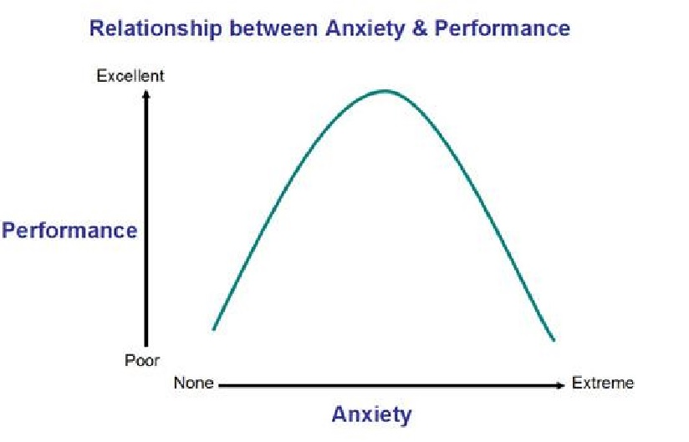
Notes:
This graphic demonstrates that we NEED anxiety to perform well.
Not enough anxiety (too relaxed, low adrenaline), performance decreases.
With extreme anxiety performance decreases too. Therefore we need optimal amount of performance.
BUT, everyone’s curves might be slightly skewed. So someone might perform their best super relaxed with no anxiety or others may perform better with more anxiety. No one is exactly in the middle. The main idea is to find how much anxiety the skater needs in order to perform their best.
Anxiety in this context can also be referred to as arousal. Arousal is just a state of increased adrenaline. This can be anxiety, excitement or fear. All those states feel physically the same but it depends on our interpretation.

Slide 18
Fight or Flight response
Sympathetic nervous system response
Cortisol and adrenaline released
Heart rate and breathing accelerate
Pupils dilate
GI processes inhibited
Blood flow increases to muscles
Glucose released into blood
Saliva decreases, sweat increases
What it means
Get ready to run away from danger. Nervous jitters and needing to take action.
Light headedness
Able to take on more information to run away from “danger”
Digestion not important in a life or death situation. Experienced as queasiness/nausea
Get ready to “fight or flight”
Quick energy to run from danger
Saliva is part of digestive system. Experienced as dry mouth and sweaty palms
Notes:
This slide explains what your body goes through in response to danger and why we feel anxious/nerves
Even though this can be a bad experience, we still need it because we need energy, need to take action, we don’t need to digest our food, we need blood flowing to our muscles during competition.

Slide 19
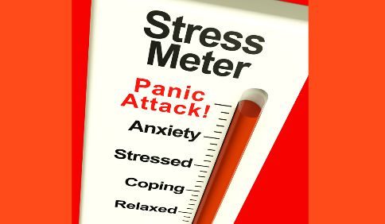

Competition as a “danger”
Competitions produce stress because they are a demanding situation and in order to succeed we must meet those demands

Slide 20
Next...
Arousal awareness and regulation

Slide 21
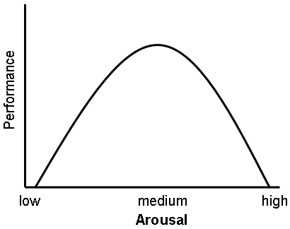
Notes:
This curve was developed with the notion that everyone’s optimum level of anxiety is right in the middle. I disagree. I have had amazing performances at lower than the middle but also at high anxiety. It changes depending on the person and the time

Slide 22
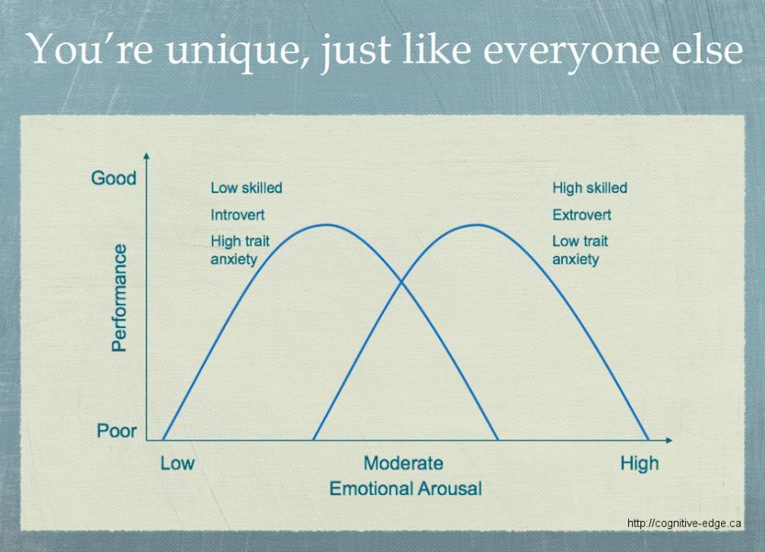
Notes:
Don’t worry too much about the jargon. This is what 2 different people’s arousal curves would look like. Now we’re going to help you find where your athlete’s curve so that you can help them self regulate

Slide 23
Optimal Arousal Level
Think back to one of your great performances. Take a few minutes to re create the whole performance
Focus on how relaxed, excited, energised or mellow you were. What do you think your activation level was? How did you feel physically? How did you feel mentally?
Now think back to your most recent poor performance. What do you remember about that experience? Were you energised to the point of being so hyper that you couldn’t stay focused? Were you constantly getting distracted? Or were you too relaxed, seemingly without the energy or strength to get through the event? What was it like? What did your body feel like? What was going on in your mind? How were you talking to yourself pre and post competition?
Notes:
Before we learn the skills, you must identify their optimal arousal.
How to identify where your athlete sits on the curve to get their best performance every time (comp and training)
It is important to be aware of what arousal level works best for them, so you can know when to make an adjustment and whether they need to be more energised or relaxed.

Slide 24
TASK 1: Think back to one of your great performances and write your answers
On a scale of 1 – 10, rank your activation level before you skated and while you skated. (1 being extremely relaxed and 10 being super energised).
What did your body feel like?
Did you feel like you had control of your body?
What was going on in your mind? What thoughts did you have while skating?
Could you control your focus? Where was your focus directed while you were skating?
In what ways did you feel similar to how you feel during practice?
In what ways did you feel different?
What else do you remember about your activation level?

Slide 25
TASK 2: Think back to one of your poorer performances and write your answers
On a scale of 1 – 10, rank your activation level before you skated and while you skated. (1 being extremely relaxed and 10 being super energised).
What did your body feel like?
Did you feel like you had control of your body?
What was going on in your mind? What thoughts did you have while skating?
Could you control your focus? Where was your focus directed while you were skating?
In what ways did you feel similar to how you feel during practice?
In what ways did you feel different?
What else do you remember about your activation level?

Slide 26
TASK 3: You may want to repeat the questions for the best and worst practices, depending on where you are having trouble with your athlete
TASK 4: Evaluate and compare the similarities and differences. Write this information down with the athlete. Use this information to increase their awareness of their optimal activation level. Talk about it with them.
TASK 5: Once they have identified this, teach them the skills they’ll need to self regulate so they can have great practices or performances
Notes:
Important so that both athlete and coach know what the athlete needs pre comp/during training
With self awareness comes self regulation (in a pre comp situation athlete can scan their physical and mental condition and decide which skill to use to get them back to their optimum level)

Slide 27
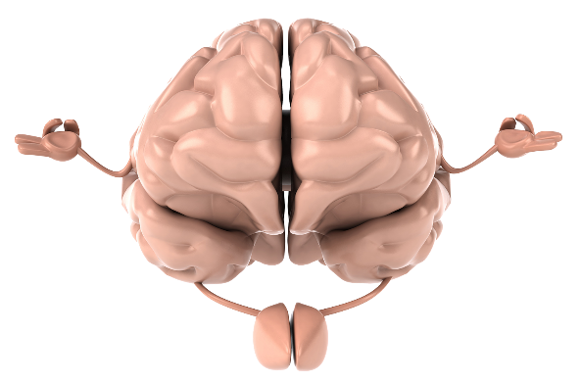
Relaxation Techniques

Slide 28
Progressive relaxation
Based on 3 principles:
Used to learn the difference between relaxation and tension in the body
Works by relaxing the muscles to relax the mind.
Based on tension/relax cycles of selected muscles
Once technique is learnt, takes less time to get same effect
Notes:
Start with a big breath in, tense your feet and hold as hard as you can then breathe out and let go. Repeat with calf muscles, thigh muscles, butt, back, chest etc moving up the body and using the breath out to fully relax each area.

Slide 29
Breath control
4 sec to inhale, 8 to exhale
Gives you something else to focus, relax the body to relax the mind
Make sure they blow up their belly
Good for stopping repetitive negative self talk
By expanding the diaphragm you’re also triggering a physical relaxation
Notes:
Counting your breaths also helps. Breahe down into your belly. Shoulders stay still.

Slide 30
Relaxation response
Based on meditation but without spiritual or religious significance. The process teaches you to quiet the mind, concentrate, and reduce muscle tension.
In a quiet place and comfortable position, use a word or thought as an anchor to this moment. Focus your attention on this word and repeat it in your head on every exhale. If something comes into your head, gently re-focus on your word on the next exhale.

Slide 31
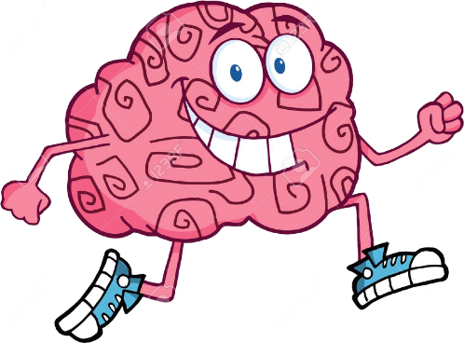
Arousal Inducing Techniques

Slide 32
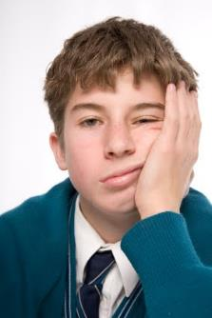
Under Activation
What it looks like:
Moving slowly/not getting ready
Mind wandering; becoming easily distracted
Lack of concern about how well you perform
Lack of anticipation and enthusiasm
Heavy feeling in the legs; no bounce
Notes:
DON’T TRY RANDOM STUFF DURING COMP IF THAT’S NOT WHAT YOU USUALLY DO. (eg energy drinks they don’t usually have. All these techniques need to be used regularly

Slide 33
Ideas on what to do
Use mood words and positive statements (ie: give them a mantra about what they’re going to do and what to focus on. Make sure it’s positively worded and focusing on getting that energy up)
Act energized so the energy will rub off on them (or get them to imagine a situation where they are energised)
Energetic music. Have a dance party!
Complete a precompetitive workout to get the adrenaline flowing
Notes:
Easier than trying to make someone calm down. Individualise to the athlete
(DON’T DO workout before comp IF THEY HAVE NEVER WORKED OUT IN THEIR LIFE)

Slide 34
Next...
Imagery (visualisation)

Slide 35
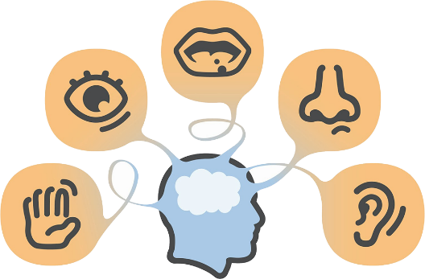
Imagery
Using all the senses to re-create an experience in the mind. Mental practice. It is important to involve as many senses as possible
Notes:
At first, athletes will most likely focus on the skill, goal, and performance in competition. Eventually they’ll learn to use all senses when recreating the situation. Keep encouraging them to imagine the noise, smell or what it feels like

Slide 36
Where and When?
Majority of research has focused on imagery during practice rather than competition but athletes appear to use more imagery during competition (pre-competition)
Coaches should concentrate on teaching during practise so it can be transferred to competition
Learning during stressful times can be
very difficult as your body is in “flight or fight” mode.
Notes:
Important that skills are learnt during practise in a relaxed environment so that all information is retained and not at competition where there are many distractions

Slide 37
Why?
Control emotions and activation levels
Builds self confidence
Imagery plays both motivational and cognitive roles in modifying behaviour.
Can be specific or general towards a situation
Enhances psych skills: CONCENTRATION,MOTIVATION, CONFIDENCE, EMOTIONAL /AROUSAL RESPONSES
Enhances sport skills: ACQUIRE, PRACTICE, AND CORRECT SPORT SKILLS. COPE WITH PAIN AND INJURY (very useful for injured athletes or for breaking bad habits)

Slide 38
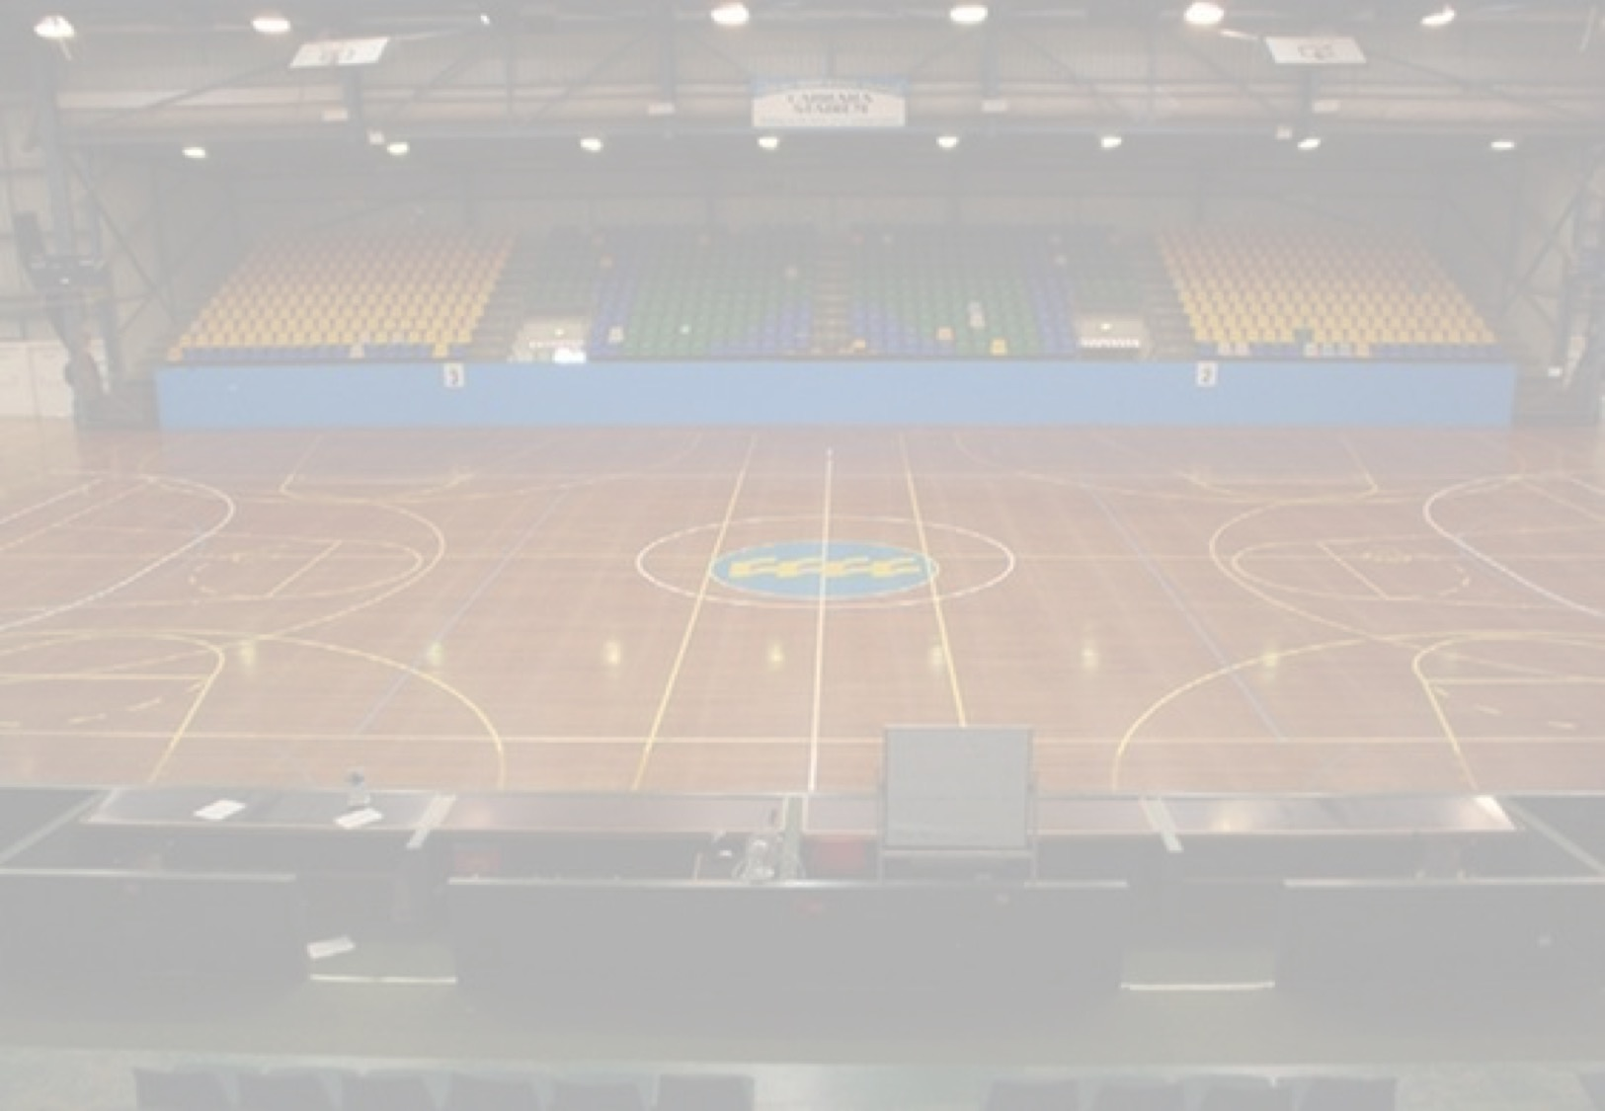
Competition surroundings
(venue, spectators)
Have your athlete imagine the rink they will skate at, where the judges are, where the audience will be, how loud it will be.
Imagine themselves coming in, getting ready, warming up, putting skates on.
Make sure they imagine this with a clear and calm mind so that they will feel clear and calm on the day.
The more you practise this calmness, the more likely it will translate to real life.
Notes:
Might be most important for figures where there is more likely to be distractions.

Slide 39
Nature of imagery
Positive imagery is mostly reported during practice and precompetition.
Negative imagery is mostly reported during competition
  During the routine focusing on NOT falling.
  Imagery that creates too much anxiety
  Imagery that directs attention to irrelevant factors
  Imagery that is not controllable (eg other competitors or judge’s thoughts), leading the athlete to imagine failure or mistakes
  Imagery that makes the athlete overconfident
Notes:
Things to watch for when using imagery

Slide 40
Type of imagery
Visual and Kinaesthetic most used and are important but the more detail added from other senses, the better. Eg: olfactory or auditory.
Notes:
Auditory might be good to imagine a figure situation where there may be noise and so distracting the athlete.
If expecting big crowds then noise might be significant. And imagining your music

Slide 41
Imagery perspective
Internal imagery: you see yourself as if you have a camera on your head. Some authors argue that this situation increases performance as it is more specific and accurate to real life situations.
External imagery: you see yourself from a perspective of an outside observer. More commonly used.
There is no conclusive research on which perspective
is better for the performance.
Quality and detail of the Image is more important

Slide 42
Factors affecting the effectiveness of imagery
Nature of the tasks: when you’re in a solo sport, good outcome because you have more control over situations
Skill level of the performer: imagery is useful for learning new skills as a novice. However, experienced performers use imagery more often, mostly for refining skills.
Imaging ability: quality of image gets better with practise
Using imagery along with physical practice = BEST PRACTISE. Makes learning new skills faster and easier

Slide 43
HOW TO APPLY IMAGERY
Practice in many settings (before bed, at the rink, during practise, during lunch, pre comp)
Relax before practicing imagery (deep breaths, comfortable position)
Avoid negative beliefs (‘this doesn’t work’) about imagery
Use vivid and controllable images
Start small. Picture simple things to get the hang of it.
Apply imagery to specific situations or skills
Use imagery about situations that cause the athlete the most stress.
Maintain positive focus (imagine performing well)
Need to spend the same time imagining that you spend performing in a real situation. Eg if routine last 2min then an image of a routine should last 2min.
Notes:
Eg imagine the situations where they’re stressed the most during competition
Michael Phelps: “there are times in my sleep when I literally dream my race from start to finish. Other nights, when I’m about to fall asleep, I visualise to the point that I know exactly what I want to do: dive, glide, stroke, flip, reach the wall, hit the split time to the hundredth, then swim back again for as many times as I need to finish the race.”
Sometimes I find it hard to do this in this much detail without taking a moment to relax first. I would use this technique after taking a few deep breaths or taking a bit of time out before getting started to make sure the routine goes calmly. Even in your head you can make mistakes or imagine being stressed.

Slide 44
Coach’s expectation can alter athletes' performance
Notes:
Something to be aware of. There’s been studies done on how the coaches treat people in a team based on their expectations for that player

Slide 45
Coach forms expectation based on person’s cues (size, gender..) and performance information (skill tests, practice behaviour…)
Coaches’ expectations influence their behaviour: frequency , quantity and quality of instruction and the type and frequency of feedback is different if you have high expectations than if your expectations are low
Low-expectation athletes perform poor because their receive less reinforcement and get less playing time. Self-confidence decrease and think that they are not good athletes
Athletes therefore confirm the coaches expectations.
Notes:
Not always true. But in order to avoid this cycle we must manage our own expectations as a coach and make sure you treat athletes like you would like to be treated.

Slide 46
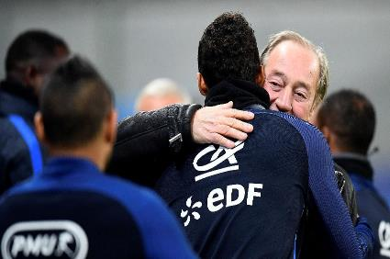
Manage your own expectations as a coach
Communication: making sure it’s athlete centred.
Always working towards the athlete’s needs and goals, not towards your own.
You’re more than a coach, you’re a mentor. They look up to you.
Neutral talk: don’t lead the conversation about bad or good performances with positive or negative talk. Pick words wisely. Try get your athlete to self evaluate their performance
Notes:
. Eg After a bad routine, instead of asking “well that was a bad routine!” or even “you did your best but...” try saying “some days aren’t as expected but what did you think of that routine?” “what was going through your head during or after that routine?” that way you have the skater’s perspective
After a bad skate, they already know they’ve done badly. They don’t need reminding. They will know you’re disappointed, it doesn’t need mentioning repeatedly.

Slide 47
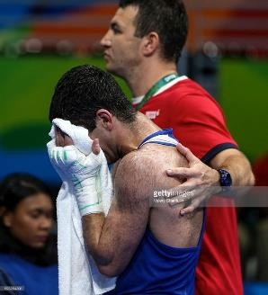
Manage your own expectations as a coach
We’ve all been there, the skater already knows they’ve had a bad day, help lead the conversation towards a more positive place to build up their confidence.
SELF REGULATE FOR YOUR ATHLETE:
most difficult skill to grasp. We must learn to take a deep breath and not let our expectations and disappointments show for the skaters.
Notes:
. Eg After a bad routine, instead of stating the obvious with “well that was a bad routine!” (even if meant in good humour) or even “you did your best but...” try saying “some days aren’t as expected but what did you think of that routine?” “what was going through your head during or after that routine?” that way you have the skater’s perspective
After a bad skate, they already know they’ve done badly. They don’t need reminding. They will know you’re disappointed, it doesn’t need mentioning repeatedly.

Slide 48
Thanks!

